Slide 1


Slide 2
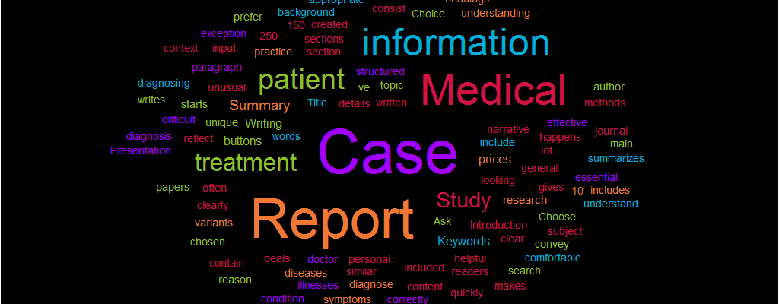


Case presentation
Acrodermatitis Enteropathica

Slide 3
PRESENTED TO
Clinical Coordinator
- Ms. Maria Aslam
Clinical Trainers
- Ms. Nida Javaid
- Ms. QuratulAin Shahid

Slide 4
Group members
Masooma Zakir 70102168
Ayesha Faisal 70059090
Iram Javed 70064074
Aiza Iqbal 70083607
Ayesha Laraib 70101967
Mariam Anees 70083586
Human Masood 70083609
Kainat Sarwar 70085630
Hajra Gondal 70083740
Momina Areej 70086786

Slide 5
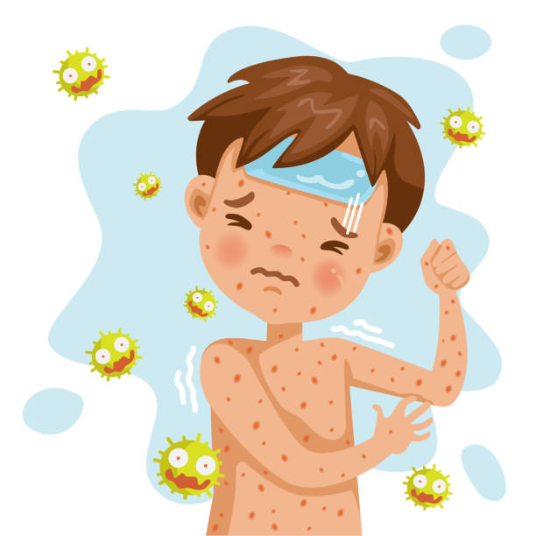
Introduction to
the disease

Slide 6
Definition
Acrodermatitis enteropathica is a rare disorder associated with zinc deficiency.
It presents with the classic triad of:
Peri-acral and periorificial dermatitis
Diarrhea
Alopecia
Acrodermatitis Enteropathica
https://dermnetnz.org/topics/acrodermatitis-enteropathica/

Slide 7
Etiology
The etiopathogenesis of this disorder may cause
zinc deficiency occurs as a result of a mutation in a zinc transport protein encoded by a gene.
https://emedicine.medscape.com/article/1102575-treatment#d8

Slide 8
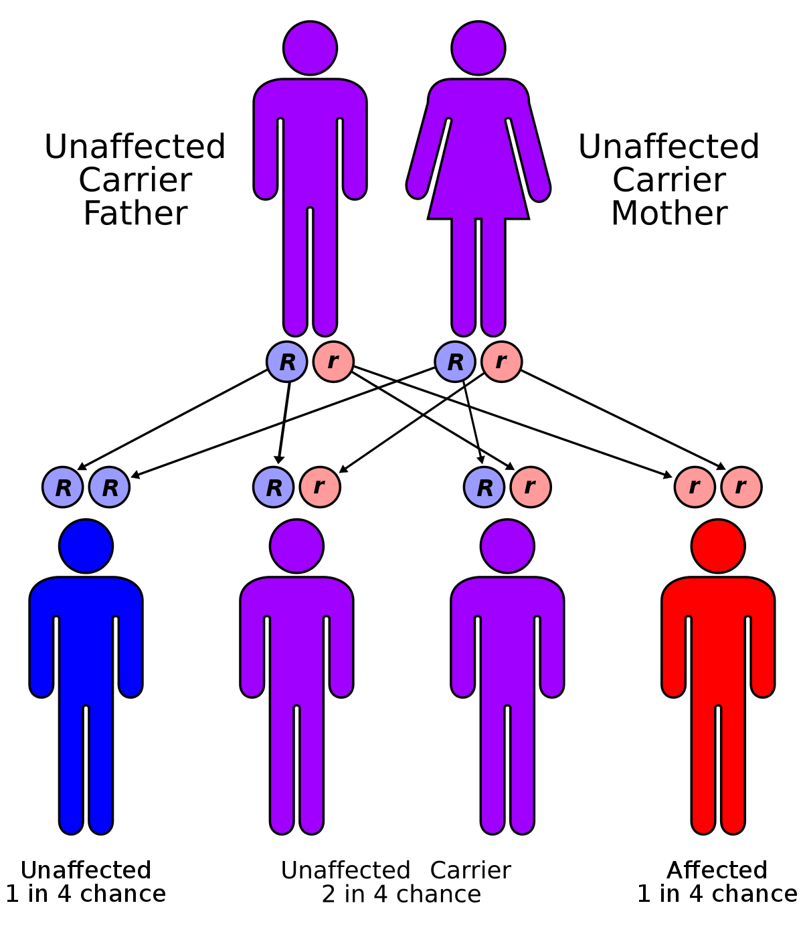
PATHOPHYSIOLOGY
Acrodermatitis enteropathica is an autosomal recessive disorder occurring as a result of mutations in a gene .
Gene encodes a transmembrane protein that is part of the zinc/iron-regulated transporter–like protein (ZIP) family required for zinc uptake. This protein is highly expressed in the enterocytes in the duodenum and jejunum
Affected individuals have a decreased ability to absorb zinc from dietary sources. Absence of a binding molecule needed to transport zinc may further contribute to zinc malabsorption.
https://emedicine.medscape.com/article/1102575-treatment#d8

Slide 9
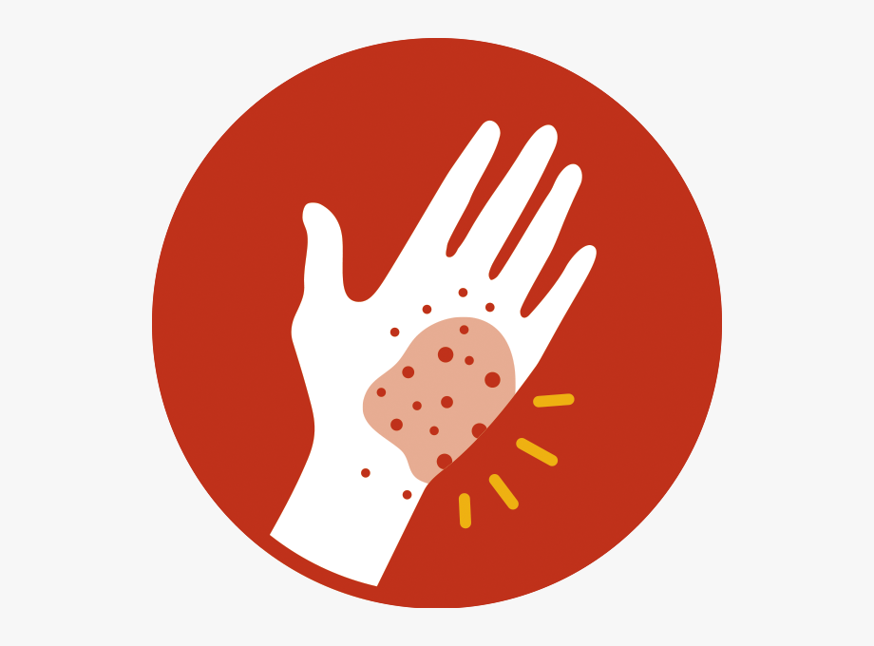
types of acrodermatitis enteropathica
01
Primary acrodermatitis enteropathica
02
Acquired acrodermatitis enteropathica

Slide 10
Primary acrodermatitis enteropathica
Primary acrodermatitis enteropathica is due to an inherited zinc transporter defect, resulting in reduced intestinal absorption of zinc.
Acquiredacrodermatitis enteropathica
Acquiredacrodermatitis enteropathica may be a result of reducedintake of zinc,increased demand, malabsorption, or may rarely be associated with certain metabolic disorders.

Slide 11


In patient data

Slide 12

In patient data
Gender: Male
Name: M. Haseeb Ahmad
Age: 12.5 y/o
Temp: 98˚ F

Slide 13


Presenting complain
&
Medical history

Slide 14
Present complain
.
Severe diarrhea (2 weeks)
Skin rash (genetically)
Medical history
.
Nausea condition
Genetically disorder

Slide 15
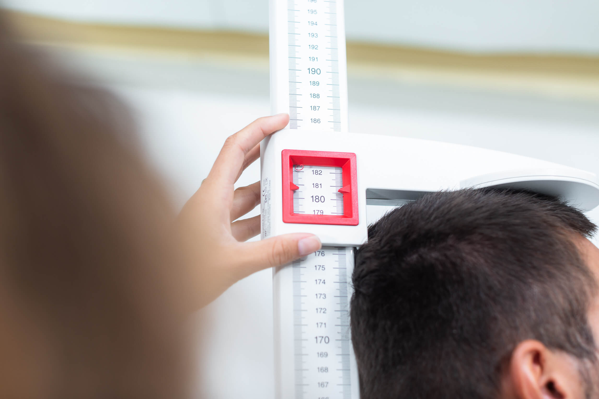
Anthropometric
measurements

Slide 16
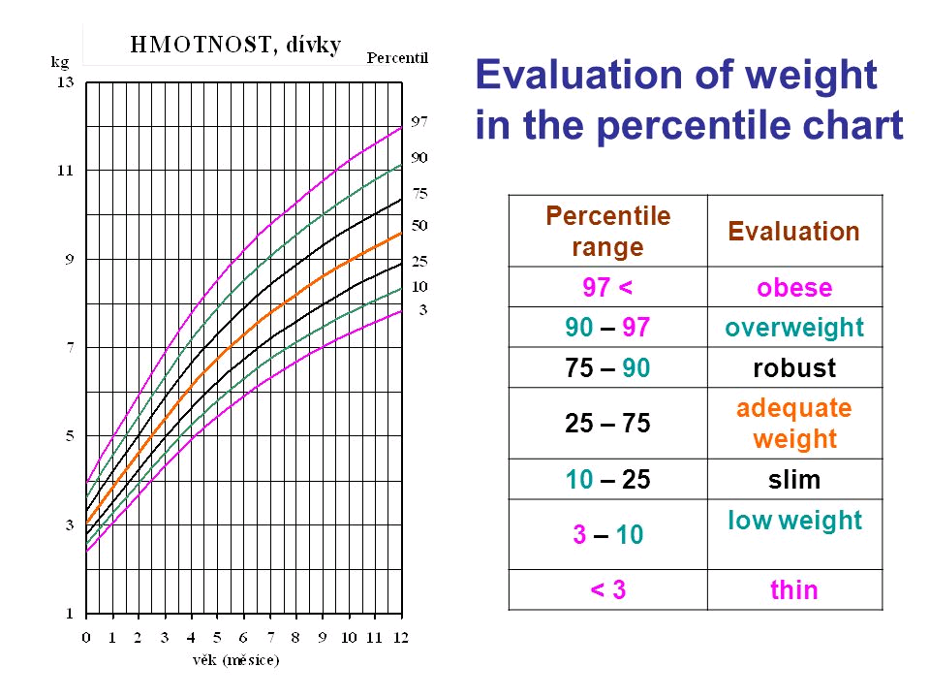
Weight: 23kg
Stature: 132cm
BMI: W/statures/straturex10000
23/ 132/ 132x 10000= 13.2 percentile
Comment: slim (underweight)
Head circumference: 53cm
Birth weight: 3.4 kg
Weight gain: Normal

Slide 17
Ideal weight
According to the Centers for Disease Control and Prevention (CDC)Trusted Source, ideal boy’s weight for12-year-old usually falls between
67 and 130 pounds (30.3-58.9 kg)
and the 50th percentile weight for boys is
89 pounds (40.3 kg)

Slide 18


Biochemical test
results

Slide 19
TEST | RESULT | NORMAL RANGE
Blood Urea | 17 | 17-43 mg/dl
S. cretinine | 0.5 | 0.67-1.17 mg/dl
TLC | 6.7 | 4.5-11.0 x 109 /L.
Esr | 294 | 0 and 15 mm/hr
Hb | 11.1 | 13.5 to 17.5 g per dl

Slide 20


Clinical evaluations

Slide 21
Clinical evaluation
Muscle wasting (low caloric intake) | Muscles weakness (present) | wasted muscle
Gums (normal) | Swallow | fissures
Nails (low Hb) | Pale (yes) | Spoon shape
Tongue (normal) | Swallow | purplish
Hair (zinc deficiency) | dull | Thin (bald)
Skin (low hb & disorder) | dry | pale (yes) (rashes)
Teeth (normal) | Cavities | missing

Slide 22
GI Functions
Appetite | normal
Nausea | Present
Anorexia | Absent
Vomiting | Absent
constipation | Absent
others | Severe diarrhea

Slide 23

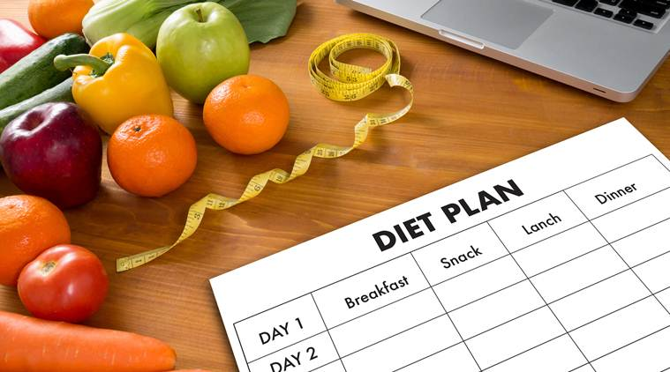
Dietary history

Slide 24
24 hr recall
Food Group | Food Items | Quantity | Exchanges | Calories
Milk Products | Tortilla | 2 | 2 Milk | 240
Fruits | Banana Apple | 1 half | 1 Fruits ½ Fruits | 60 30
Vegetables | potato & capsicum | 1 cup cooked | 2 veg | 50
Bread and Cereals | Tortilla Rice Biscuit | 2 2/3 cup 1 pack | 2 CHO 2 CHO 2 CHO | 160 160 160
Meat | None | None | None | None
Total | - | - | - | 860 kcal

Slide 25
Dietary history
Feeding practice | None
No. of feeds per day | None
Start of weaning | 6 months
Type Weaning food | Cerelac, yogurt
Food allergy | None
Sleep cycle | 8-9 hr/ day
Physical activity | Normal

Slide 26
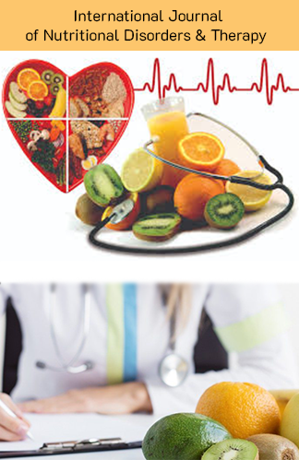
Nutrition diagnosis

Slide 27
NUTRITIONAL
Iron deficiency anemia related to poor food intake & low dietary intake of iron as evidenced by pallor of skin and nails, marked Hb level = 11.1 g/dl which is lower than normal range
Anemia
Zinc deficiency related to Poor zinc intake & Genetic disorder as evidenced by Dermatitis &amp; Body hair loss
Zincdeficiency
Severe diarrhea related to zinc deficiency & inadequate dietary zinc absorption as evidenced by increased bowel movement i.e.5-6 or more times a day (watery stools).
Severe diarrhea
Malnourishment related to low caloric intake as evidenced by body weight = 23kg, marked BMI =13.2 percentile which is lower than normal range.
Underweight
DIAGNOSIS
PES

Slide 28
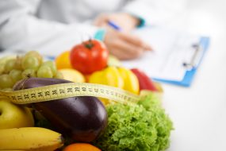

Medical nutritional
Therapy

Slide 29


Slide 30
Recommendations
FEEDING ROUTE
Oral route
MECHANISM OF DIET
Soft diet
TYPE OF DIET
Brat
Balanced diet
SUPPLEMENTATION
Zinc sulphate sachet

Slide 31

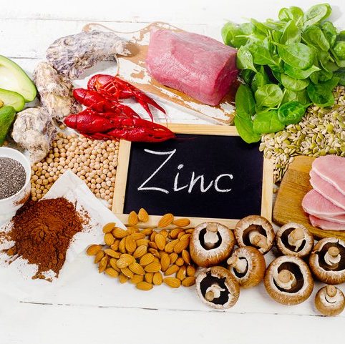
Medical Nutrition Therapy
Above all Zn rich foods must be added to diet i.e. meat, legumes, seeds, nuts, dairy products, eggs, whole grains
Treatment of primary acrodermatitis enteropathica begins with high-dose supplementation using oral elemental zinc at 3 mg/kg/day
Treatment of acquired or dietary zinc deficiency begins with 0.5-1 mg/kg/day of elemental zinc while the malnutrition is being treated
Zinc can be given during pregnancy
Notes:
https://emedicine.medscape.com/article/1102575-treatment#d8

Slide 32

Supplementation
Although no special diet is required for acrodermatitis enteropathica patients, as long as zinc supplementation is continued, certain foods contain some levels of zinc, including shellfish, beef, legumes, and nuts.
But the level of zinc & its bioavailability is not enough to lower the symptoms , that is why we choose supplementation. Zinc guconate & sulphate are most suitable for this purpose.
Zinc sulfate preparation may cause gastrointestinal irritation and the gluconate or acetate preparations can be tried where available
Notes:
https://emedicine.medscape.com/article/1102575-treatment#d8

Slide 33
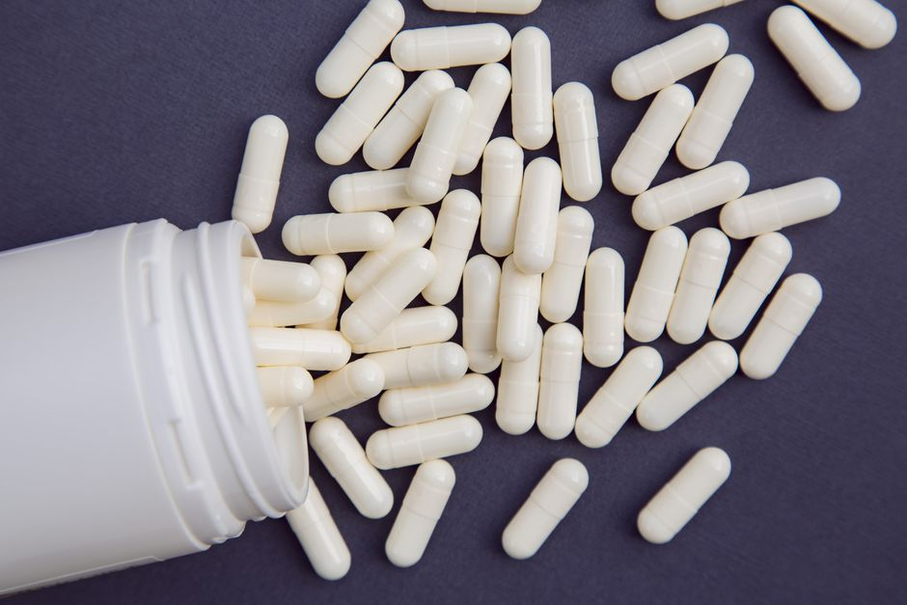
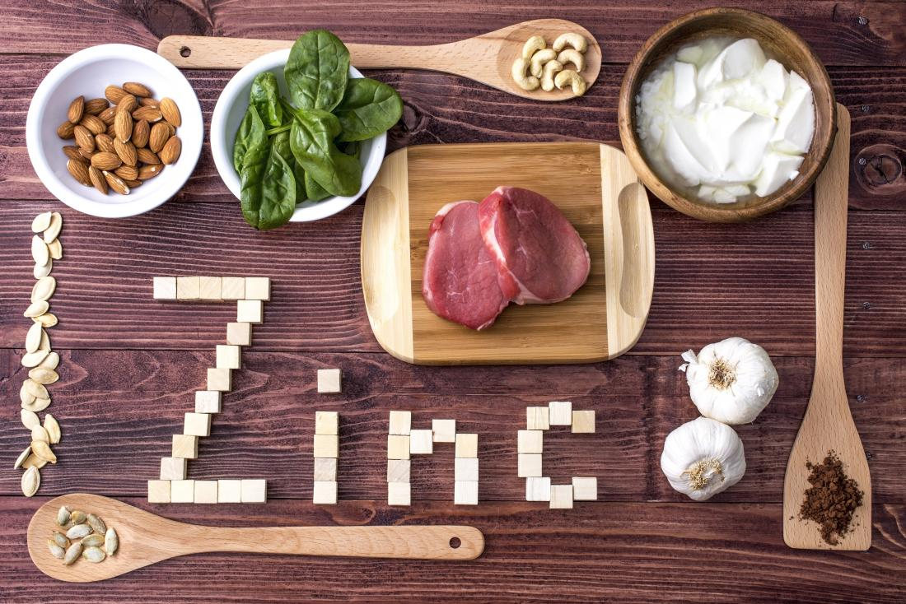
Monitoring
Blood zinc levels should be measured every 3–6 months with adjustment to the lowest effective dose. Full blood count, alkaline phosphatase, and copper levels may be useful for additional monitoring
Notes:
https://emedicine.medscape.com/article/1102575-treatment#d8

Slide 34
Toxicity
Normal doses of zinc are generally well tolerated but overdose may cause toxicity.
Acute zinc overdose may cause vomiting, diarrhea, abdominal cramps, lethargy, lightheadedness, and gait disturbance
Chronic zinc overdose may lead to neutropenia, leucopenia, copper and iron deficiency anemia, growth retardation and lipid abnormalities
Notes:
https://emedicine.medscape.com/article/1102575-treatment#d8

Slide 35
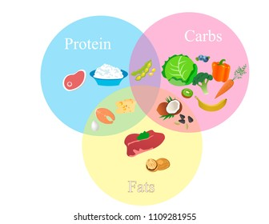
Macronutrients
Division

Slide 36
Macronutrients Division
CH0 = 50%
Justification:
One of the purposes of giving lowest range of carbohydrate is for diarrhea because it is a high fiber source, which may increase bowel movement
While body needs it to provide enough to fulfill the calories.
One way is to eat foods that have low Fiber in it.
Another way can be by low carb diet. A low carb diet is usually one that gets 40-45 percent of its calories from carbohydrate.

Slide 37
Macronutrients Division
Protein=20%
Justification:
Moderate amount of protein is require for reducing muscle weakness.
High protein can lead to increase bowel movement so moderate amount of protein is feasible
Lean protein sources are much favorable to fulfill the requirement

Slide 38
Macronutrients Division
Fats = 30%
Justification:
Sometimes fats gives the body hard time for digesting.
When fatty foods are not absorbed normally, they go to the colon, where they are broken down to fatty acids, causing the colon to secrete fluid and trigger diarrhea, that is why we reduces the intake of fats

Slide 39
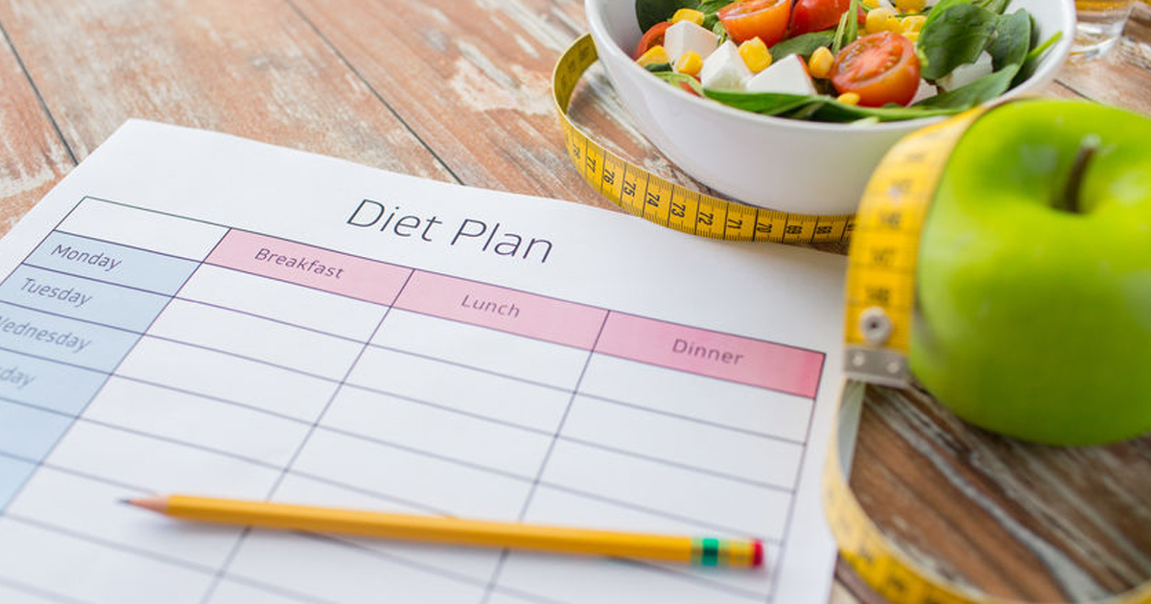

Diet planning

Slide 40
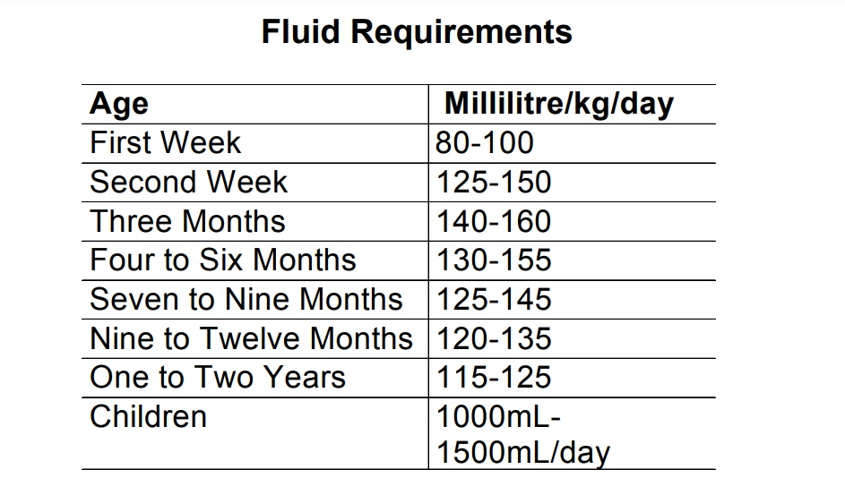
1000 mL /day is required

Slide 41
Caloric Calculations
BEE:
=66.5+(13.8xwt.)+(5xht)-(6.8xage)
=66.5+(13.7x23)+(5x132)-(6.8x12)
=1058 kcals/day
Multiplied by Injury Factor for Mild Infection = 1.0

Slide 42
BRAT DIET CHART
MEALS | FOOD ITEMS | QUANTITY | EXCHANGES | Calories
PRE- BREAKFAST | Yogurt | 1 cup | 1 Milk | 120
BREAKFAST | Bread Apple Sauce | 1 Slice 1 Tbsp | 1 CHO 1 Fruit | 80 60
MID MORNING SNACK | Banana | 1 | 1 Fruit | 60
LUNCH | Boiled Rice Vegetable Curry | ½ cup ½ cup | 1 CHO 1 Veg | 160 25
EVENING SNACK | Sliced Apple | 2 | 2 Fruits | 120
DINNER | Khichdi | ½ cup | 1 CHO | 80
BED TIME SNACK | Yougurt | ½ cup | 1 Milk | 120
TOTAL |  |  |  | 1025 kcals

Slide 43
Our First diet plan consist of
BRAT diet is to treat current condition i.e. Severe diarrhea. It will be useful till a short duration. Because it is consist of LOW fiber food ,which may stop diarrhea by firming up stool & decreasing the bowel movement .
After the cure of diarrhea we can switch our diet plan from BRAT to more healthier one (according to our nutritional requirement)

Slide 44
BALANCED DIET CHART
MEALS | FOOD ITEMS | QUANTITY | EXCHANGES | Calories | Zn amount (mg)
PRE- BREAKFAST | Almonds | 4 | 1 Fat | 42 | 0.16
BREAKFAST | Scramble egg Reduced milk Bread | 1 ½ cup 1 slice | 1 Pro ½ Milk 1 CHO | 90 kcal 60 65 | 0.64 0.15 0.22
MID MORNING SNACK | Yogurt Banana | ½ cup ½ | ½ Milk | 60 57 | 1.09 0.9
LUNCH | 6 inch chapatti Legumes Chopped vegetable salad | 1 ½ cup ½ cup | 1 CHO 1 Pro 1 Veg | 80 80 28 | 0.16 0.85 0.36
EVENING SNACK | Fruit juice diluted (2 apples) | ½ cup (2 apples) | 2 Fruits | 120 | 1.54
DINNER | Meat Rice Chopped vegetables | 3 oz ½ cup ½ cup | 3 Pro 1 CHO 1 Veg | 214 90 25 | 2.7 0.39 0.36
BED TIME SNACK | Reduced milk with | ½ cup | ½ Milk | 60 | 0.15
TOTAL |  |  |  | 1073 kcals | 8.86 mg

Slide 45
Case Pictures

Slide 46
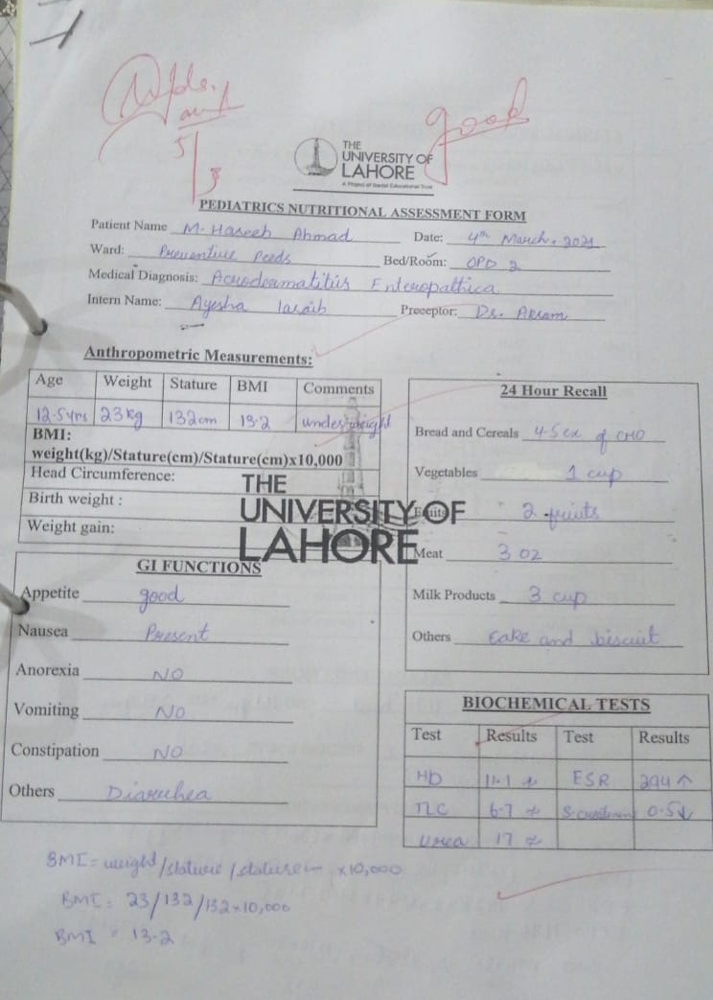
Case Form

Slide 47
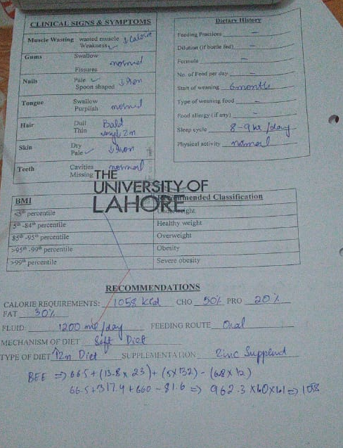
Case Form

Slide 48
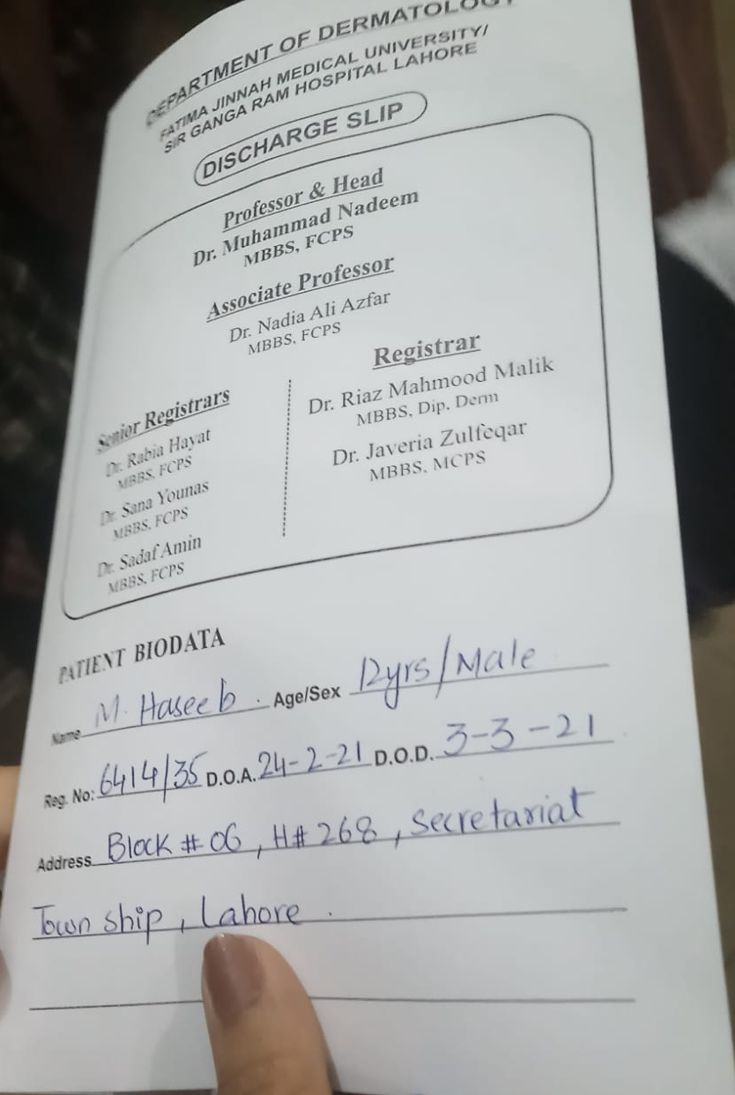
File picture

Slide 49
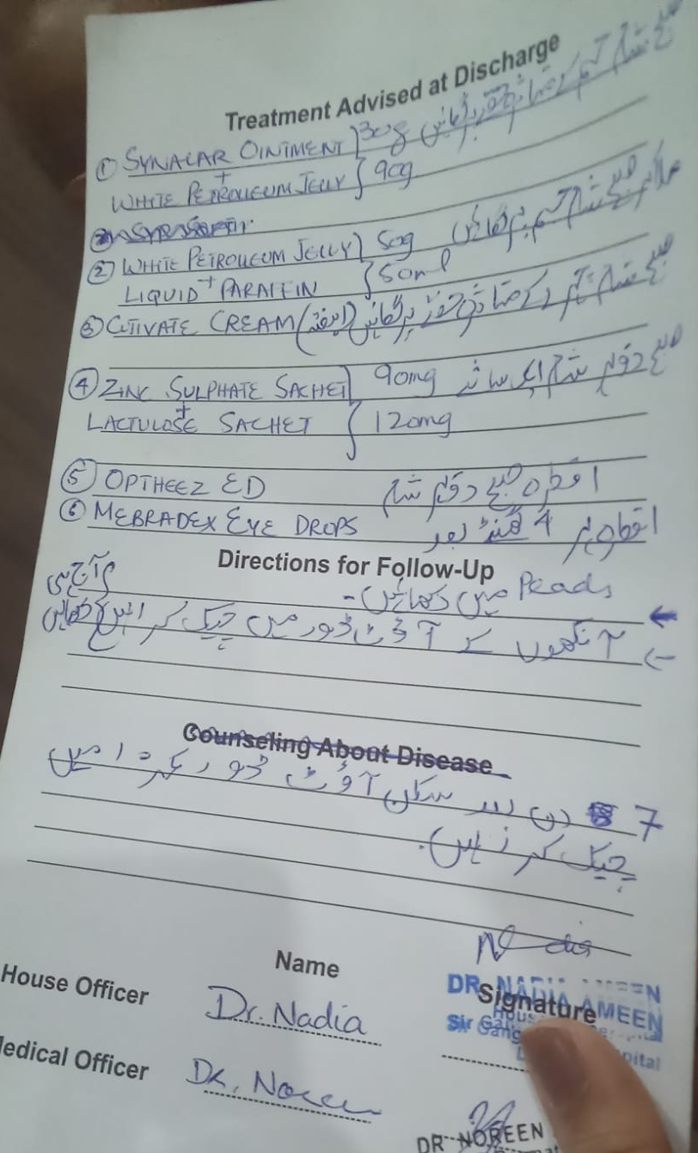
File picture

Slide 50
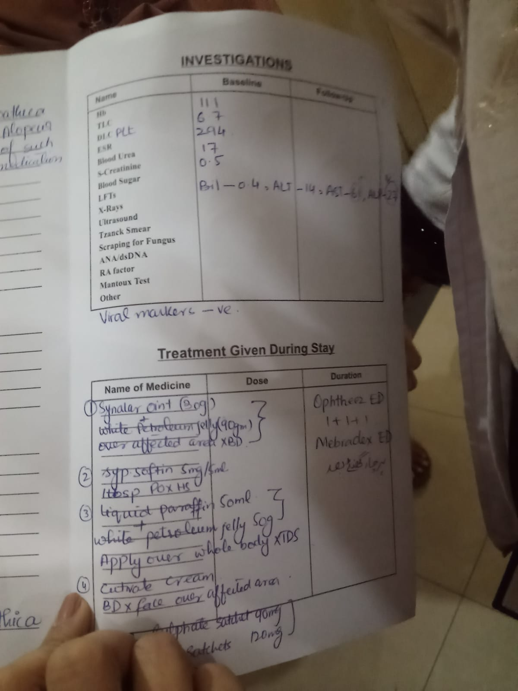
File picture

Slide 51
References
https://emedicine.medscape.com/article/1102575-treatment#d8
https://dermnetnz.org/topics/acrodermatitis-enteropathica/

Slide 52
Nutrition Camp Report
A Basic Guide To Healthy Eating

Slide 53
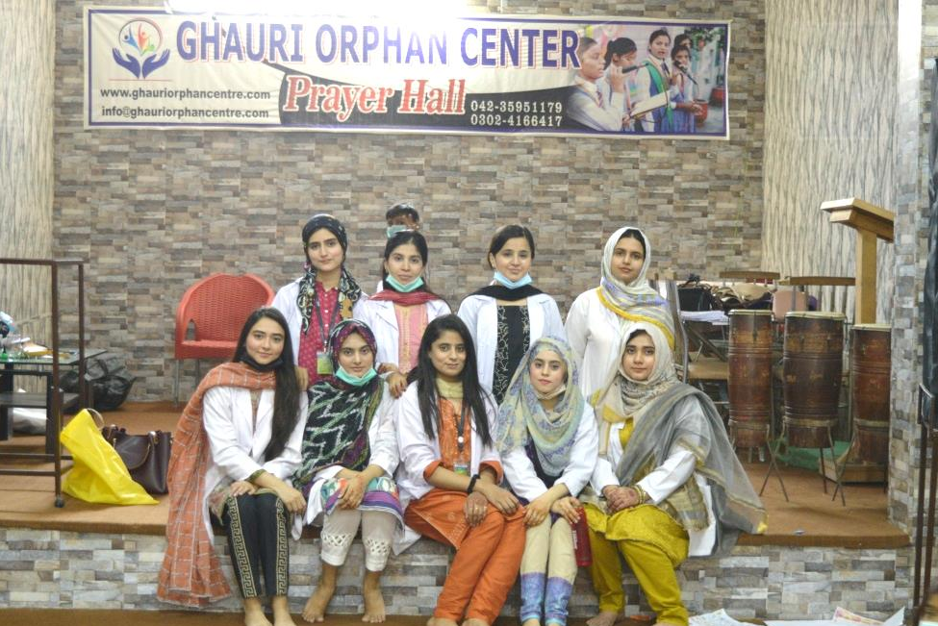
Camp Members
Ayesha Faisal DDNS02163232
Iram Javed DDNS02163192
Masooma zakir DDNS02171093
Aiza Iqbal DDNS02163041
Humna Masood DDNS02163101
Maryam Anees DDNS02163062
Ayesha laraib DDNS02171092
Kainat sarwar DDNS02163288
Hajra gondal DDNS02163218
Momna areej DDNS02163310

Slide 54

Ghauri Orphan Center
It is non profit organization that is currently working under 5 different pillars
Orphanage
School
Farm
Leprosy Mission
Disaster Relief
Provide Shelter, Food, Health and Education
For more than 70 years, working to bring as much love to as many unwanted children as possible.

Slide 55
Camp Report
Date : 17 May, 2021
This camp was conducted on 17 may,2021 at orphan center in order to provide basic nutrition guide to the children present there
This objective was fulfilled by performing a number of activities, with the help of assessment forms and brochures
Audience was engaged in questioning session regarding food groups and food items
Anthropometric measurements were recorded moreover eating pattern was also observed
At the end of camp children were given goodie bags of different stationary products
Timing: 11:00am-1:00pm
Venue: Ghauri Orphan Center

Slide 56
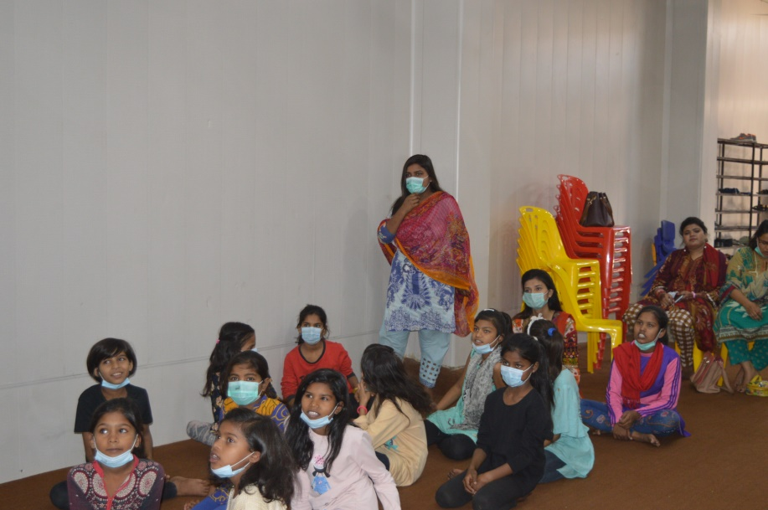
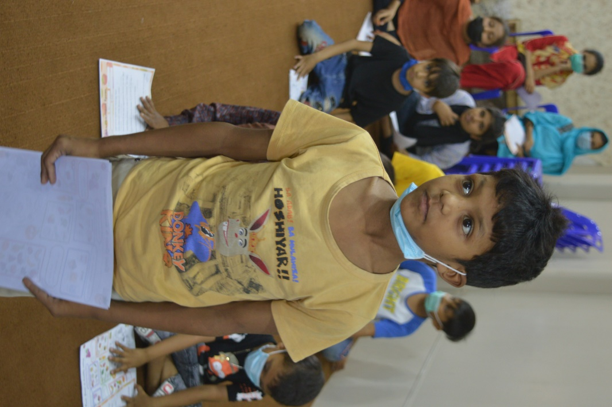
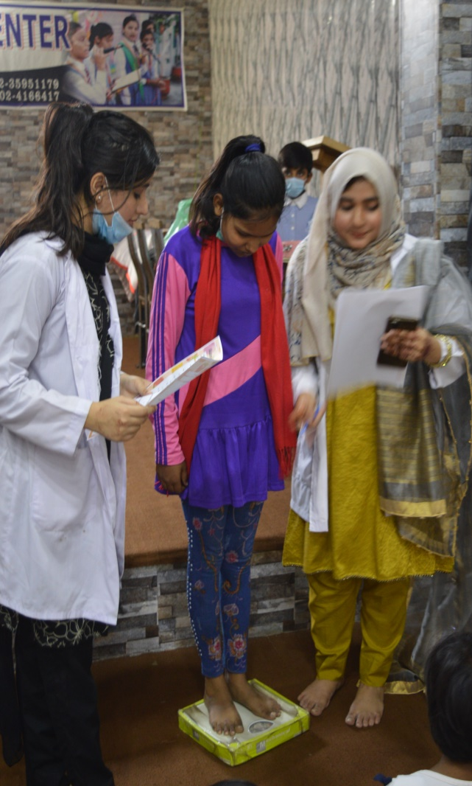
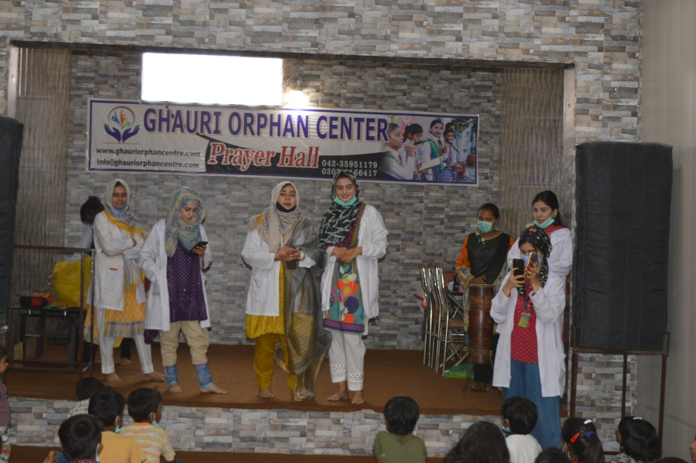

Slide 57
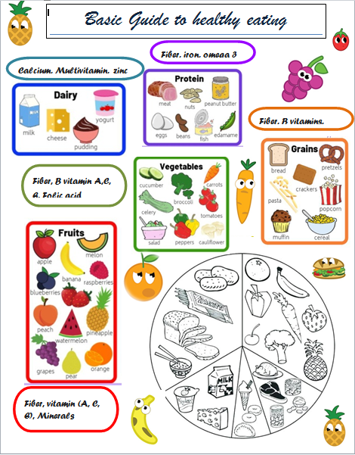
Activities
Children were asked to match the food groups
They were asked to color the items in food groups
They also participated in activity of mentioning different food products made from each food group

Slide 58
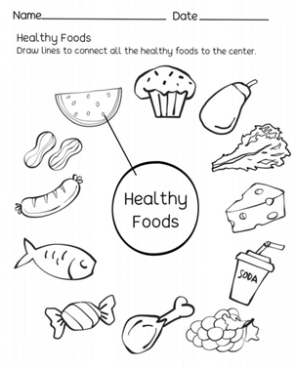
Activities
Children also played this activity
They colored all the healthy foods
They also matched all the healthy foods to the heading

Slide 59
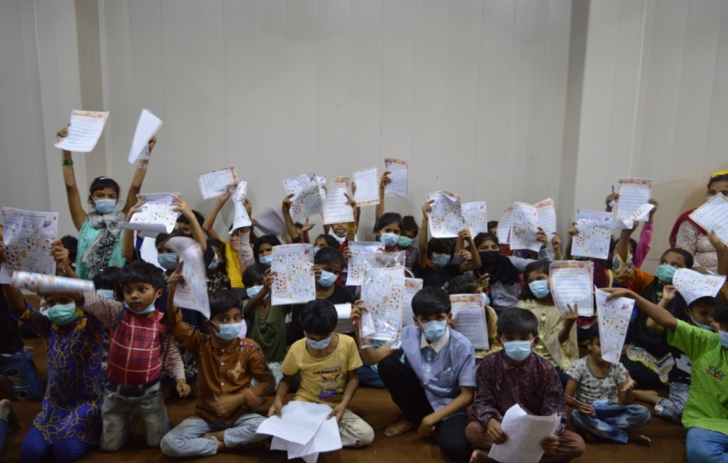
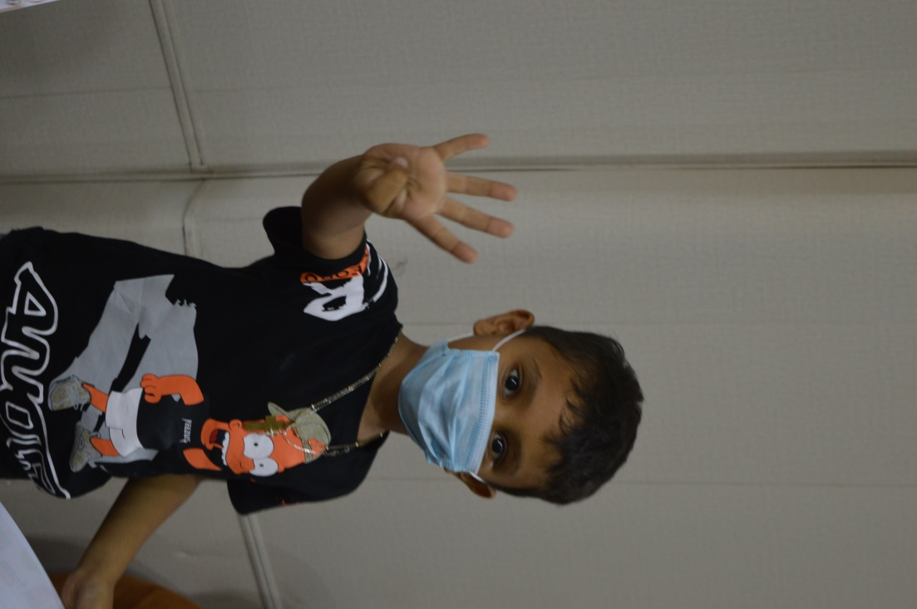
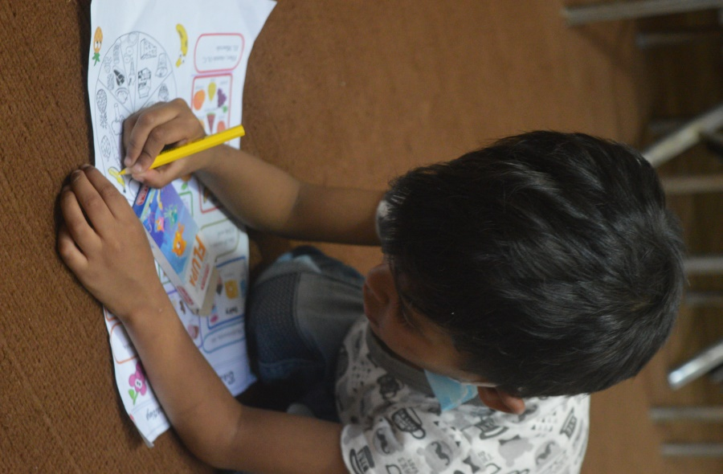
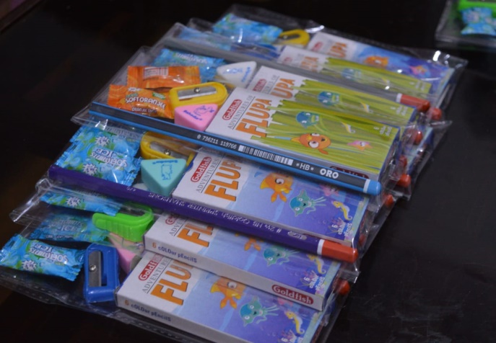
Goodie Bags
Children used these colors to perform the activities

Slide 60
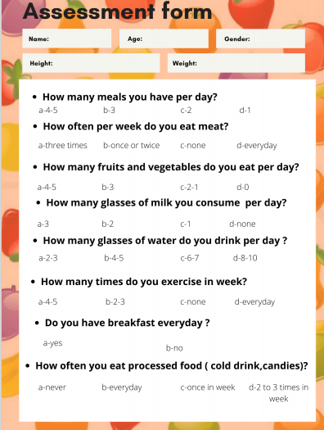
Assessment forms
These forms were filled for each child with the assistance of camp members
These forms helped us to learn not only the anthropometric measurements but also the eating pattern of children
A high rate consumption of processed food was observed
Children also skipped vegetables from their diet

Slide 61

Means of Publicity & Advertisement
Different social apps were used like Whatsapp, Facebook and Instagram

Slide 62
Socioeconomic Impact
There was a total expense of approximately 5000 Rs.
Each person paid 500 Rs.
Items | Expense
Pencils | 400 Rs.
Erasers & Sharpners | 300 Rs.
Colors | 1650 Rs.
Packing | 330 Rs.
Pens | 1000 Rs.
Markers | 350 Rs.
Printing | 760 Rs.
Total | 4890 Rs.

Slide 63
Social Impact
It is very important to raise awareness in children about healthy eating in order to maintain a healthy lifestyle
As eating habits of early childhood majorly affect nutritional status of a person in later age
Children didn’t know about the basic food groups
They were provided enough knowledge to improve their eating habits and to live a healthy lifestyle

Slide 64


